Slide 1

Can you guess
The Number?
Game Project
20/01/2023

Slide 2



AWESOME TEAM
Gabrielle
Rachad
Yen LE

Slide 3
Easy Level : Guess Number 1 to 10
5 attempts
?
Medium Level : Guess Number 10 to 100
7 attempts
Hard Level : Guess Number -500 to 500
10 attempts

Slide 4
GAME DESCRIPTION
The goal of this game is to guess a number generated randomly by the computer.
Three levels of difficulties are suggested in this game:
easy level: numbers between 1-10 and 5 attempts
medium level: numbers between 10-100 and 7 attempts
hard level: numbers between -500-500 and 10 attempts

Slide 5
CHALLENGES
CHALLENGE 1: Make sure the input entered is good
CHALLENGE 2: How to make a code for 3 different levels

Slide 6
PROCESS
Build a flowchart for the different steps
Identify the different parts of the script
Build the script for the game using python
Test the script

Slide 7
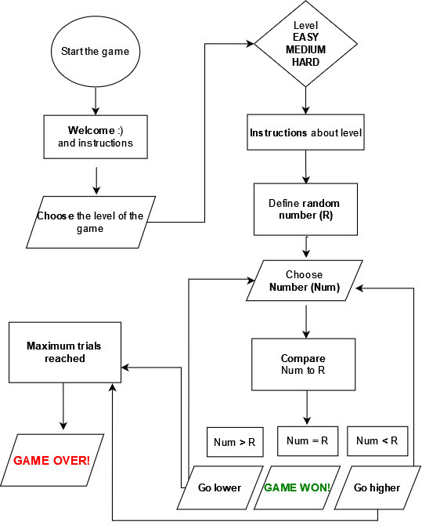
FLOW CHART

Slide 8
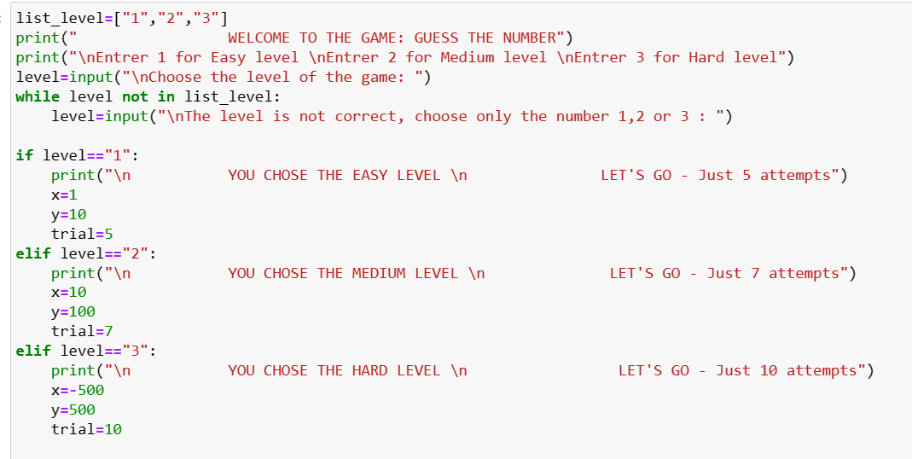
CODE

Slide 9
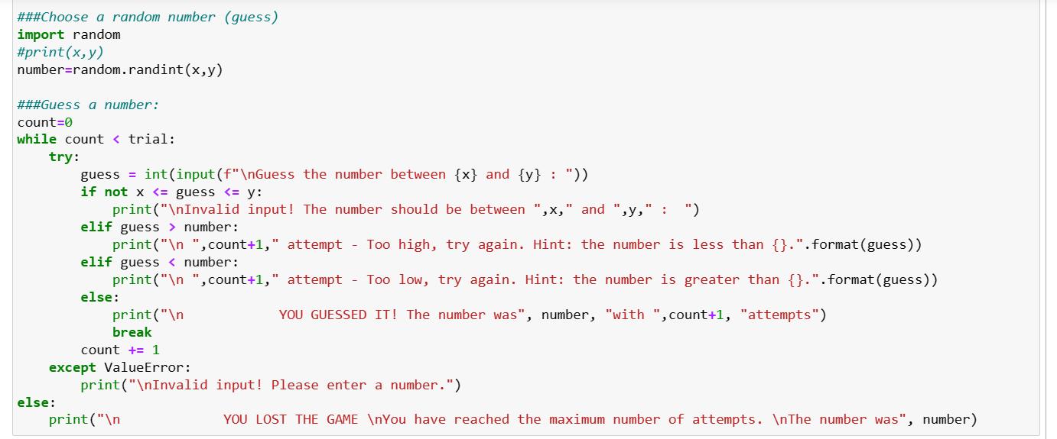
CODE

Slide 10
THANK YOU NOW LET’S PLAY

